Slide 2
Human Emotion Recognition System
Submitted to:
Department of Computer Science and Engineering

Slide 3
Supervised by: Prof.Priyanka Jangde Associate Professor, Computer Science & Engineering
Team Members
1.Aditya K.Soni (0827CS201014)
2.Aditya Paliwal (0827CS201015)
3.Aman Khan (0827CS201024)
4.Aman Kumawat (0827CS201025)

Slide 4
Project Presentation Outline
Abstract
Introduction
Problem Statement
Project Objectives
Requirement Analysis
Models and Diagrams
Conclusions and Limitations

Slide 5

Abstract
Human Emotion Detection System is an artificial intelligence-based tool that uses computer vision, machine learning, and natural language processing algorithms to recognize and analyze human emotions. The system can detect emotions like happiness, sadness, anger, fear, surprise, disgust, and neutral from facial expressions

Slide 6
Introduction
Human Emotion Detection System is a cutting-edge technology that aims to revolutionize the way computers interact with humans. It uses advanced algorithms to detect and analyze emotions from various sources such as facial expressions. With the rapid advancement of artificial intelligence, it is now possible to develop systems that can understand human emotions and respond in a meaningful way.

Slide 7
The Problem Statement
The problem, therefore, is to develop a robust and reliable Human Emotion Detection System that can accurately detect emotions from various sources and respond appropriately. This requires developing algorithms that can effectively capture the complex and dynamic nature of human emotions

Slide 8
Objectives
The aim of this system is to improve human-computer interaction by enabling machines to understand human emotions and respond appropriately.
To increase the accuracy of given dataset

Slide 9
Requirement Analysis
Functional requirements
Emotion recognition accuracy: The system should accurately detect and categorize emotions from facial expressions
Data source integration: The system should be able to integrate with multiple data sources such as cameras, microphones, and sensors
Real-time processing
Emotion categorization

Slide 10
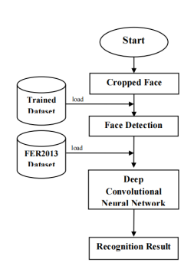
Diagrams
Flow Diagram

Slide 11
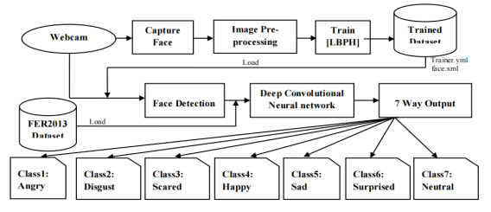
Diagram
System Diagram

Slide 12
Resources required
Hardware: hardware such as camera A computer or server with sufficient processing power and memory is also needed for running the algorithms and storing data.
Software: Software tools for data preprocessing, machine learning, and deployment may be required, such as programming languages such as Python, libraries for data analysis and visualization such as NumPy, Pandas, and Matplotlib, and machine learning frameworks such as TensorFlow and PyTorch.
Data: A large amount of data is typically required for training the machine learning models

Slide 13
Implementation
The implementation of a Human Emotion Detection System using Local Binary Patterns Histograms (LBPH) can involve the following steps:
Data Collection: Collect data from various sources such as cameras, microphones, and physiological sensors to obtain input for emotion detection.
Data Preprocessing: Preprocess the data to prepare it for analysis, such as removing noise, normalizing values, and transforming data into a format that is suitable for the analysis algorithms.
Face Detection: Detect faces in the images using a face detection algorithm such as Haar cascades or Single Shot MultiBox Detector (SSD).
Feature Extraction: Extract features from the detected faces using the LBPH algorithm. This involves creating a histogram of the binary patterns of pixel intensities in an image.
Model Training: Train a machine learning model, such as a support vector machine (SVM) or a neural network, on the extracted features to learn the relationships between the features and emotions.
Model Evaluation: Evaluate the performance of the trained models by testing on a validation data set and adjusting parameters as necessary.
Deployment: Deploy the final models in a real-world setting and integrate with the data sources to detect emotions in real-time.
Result Presentation: Present the results of the emotion detection to the user in a clear and concise manner, such as through a graphical user interface or an application programming interface.

Slide 14
THANKS

